Slide 1


Chapter 11 – HOUSING DISCRIMINATION (& RESIDENTIAL SEGREGATION)
BY JOSH FEATHERMAN

Slide 2

DEFINITION
According to the Fair Housing Act of 1968, housing discrimination is discrimination in the sale, rental, or financing of housing on the basis of race, gender, national origin, disability, or other characteristics.
Both governments and the private sector can discriminate against individuals in the housing market.

Slide 3

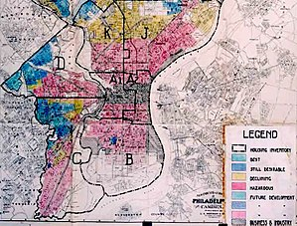
HISTORY: 1930s-1950s
Racial segregation in the housing market is legal across the United States, is ubiquitous, and is encouraged by federal policies.
1933-34: Federal government under FDR establishes home-loan assistance programs, but “redlining” limits loans to African Americans.
Federal Home Ownership Loan Corp. designates minority neighborhoods on maps as “uncreditworthy” in red, making it hard for them to get federal loans or loans from private lenders.
1948: Supreme Court issues landmark ruling holding that courts cannot enforce racial covenants on real-estate.
Covenants were contracts used in the past by real estate firms to prohibit the sale of property to mostly African Americans and Jews.
1951: Highlighting the terrible racism of this era, a race riot breaks out in Cicero, Illinois after a black family moves into a white apartment complex.

Slide 4



HISTORY: 1960s-1970s
Federal government takes major steps to bar racial discrimination in the housing market.
1962: President Kennedy issues an executive order prohibiting racial segregation in housing owned or financed by the federal government.
1968: One week after MLK’s assassination, President Johnson signs the Fair Housing Act, the most significant anti-housing discrimination law in U.S. history.
FHA prohibited discrimination based on race, national origin, or other factors.
1974: Fair Housing Act is amended to prohibit gender-based discrimination.
1974: Equal Credit Opportunity Act passed which prohibits discrimination by lenders.
1974: Section 8 program established which provides subsidies to low-income renters.
1975: Home Mortgage Disclosure Act passed which gathers demographic data from mortgage lenders.
Significant because helps detect discrimination.
1977: Community Reinvestment Act passed which requires federally regulated financial institutions to meet the credit needs of their communities.

Slide 5

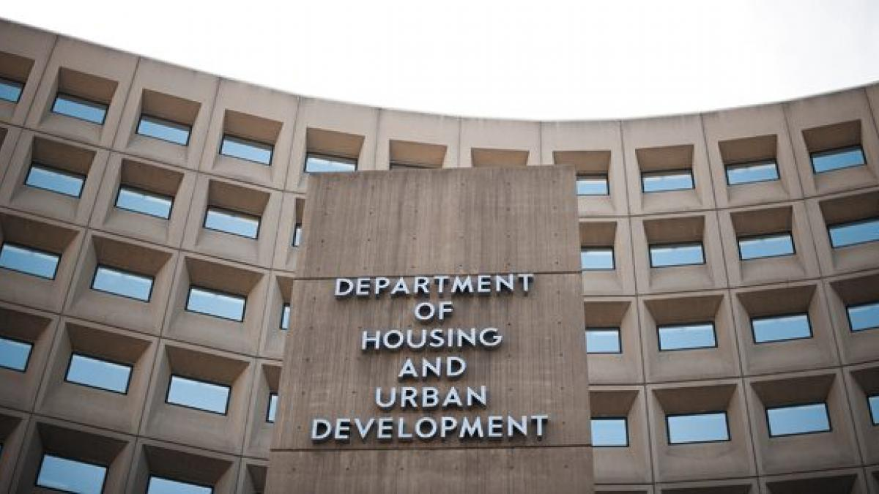
HISTORY: 1980S-1990S
Fair-housing enforcement is strengthened by Congress.
1985: Yonkers, NY is ordered by a federal judge to build housing for minorities in a predominately white neighborhood.
Municipality refused up until the brink of bankruptcy, illustrating the political challenges associated with residential integration.
1986: Low-Income Housing Tax Credit program created to finance construction of low-income housing.
Requires developers who want tax credits to build a certain percentage of affordable housing units for low-income tenants.
1988: Fair Housing Act amended to protect individuals based on familial status and disabilities.
1988: Amendments strengthen HUD enforcement authority.
Gave HUD the ability to file discrimination complaints and consider “disparate-impact.”
1990s: HUD is sued over a dozen times for concentrating public housing in minority neighborhoods.
Problematic because it reinforces residential segregation and its negative effects such as poor schools, high crime, and limited economic opportunities.

Slide 6
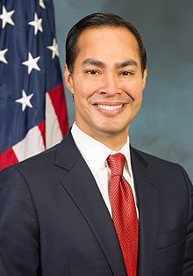

HISTORY: 2000-PRESENT
Many municipalities remain segregated, but residential segregation has declined overall.
2005: HUD found guilty in a influential Baltimore case of failing to disperse affordable housing throughout the metropolitan region.
2012: Texas public housing agency found guilty in federal court of awarding tax-credits for affordable housing in Dallas minority neighborhoods.
Justified on “disparate-impact” grounds; residential segregation has a disparate impact on African Americans as a group, even if the agency didn’t intend to discriminate against any one individual.
2012: Wells Fargo settles lawsuit accusing company of discriminating against minorities in its mortgage lending for $175 million.
2013: Study commissioned by HUD disturbingly finds that real estate agents and firms still frequently discriminate and racially screen against African Americans and other minority groups.
2015: “Disparate impact” liability for housing policies that result in segregation upheld 5-4 by conservative Supreme Court.
2015: HUD under President Obama issues controversial “Affirmatively Furthering Fair Housing” rule to enforce FHA obligations.
FHA required local governments to “affirmatively further integration,” but HUD originally had limited enforcement ability. Political will also lacking.

Slide 7

OBAMA HUD: AFFH RULE
“[Affirmatively furthering fair housing] means taking meaningful actions, in addition to combating discrimination, that overcome patterns of segregation and foster inclusive communities free from barriers that restrict access to opportunity based on protected characteristics” (HUD).
AFFH requires local governments to submit plan to HUD explaining how they are taking “disparate impact” concerns into account in their housing plans. HUD must approve of the plan before federal housing funds are released (HUD).
HUD provides local governments with expertise and guidance on how to comply with the rule.

Slide 8


HISTORY: 2000-PRESENT
2018: The Trump administration has weakened and sought to suspend the Obama HUD’s AFFH rule as well as attempted to revise the agency’s disparate impact rule (Yentel).
2018: HUD Secretary Carson has described the AFFH rule as “social engineering” similar to “the failed socialist experiments” of the past and wants to replace it (Yentel).
2018: Trump HUD disputes the “neighborhood effects” theory regarding the concentrated poverty associated with residential segregation despite significant evidence (Yentel).

Slide 9

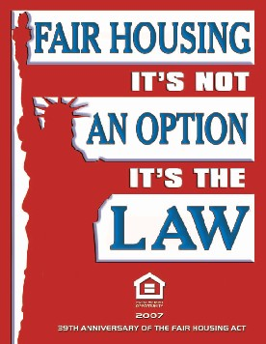
2014 HOUSING DISCRIMINATION COMPLAINTS BY TYPE (APPROX.)
Disability—52%
Race/Color—23%
Families with Children—11%
National Origin—11%
Sex—7%
Religion—1%
Other—8%
The disabled are the most overtly discriminated against in the housing process. FHA says that landlords must rent to the disabled and can be required to make structural modifications or reserve parking spots at the expense of the renter.

Slide 10
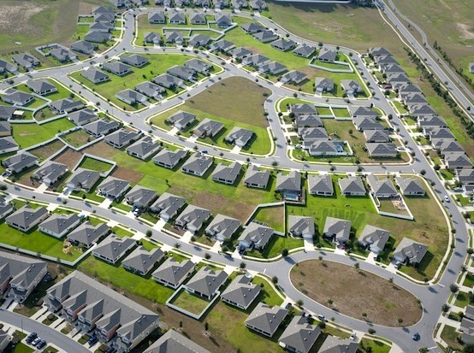

Current POLICIES CONTRIBUTING TO RESIDENTIAL SEGREGATION
Continuing practice of concentrating public housing in minority neighborhoods.
Awarding of LIHTC to builders in minority neighborhoods.
Can be justified if main goal is to build affordable housing.
Exclusionary zoning in predominately-white suburbs.
Increases price of housing and can price out low-income minorities.
Lack of federal funding for HUD and its enforcement efforts.
Much Republican opposition to federal efforts, issue not a priority for the party.
Most municipalities allow landlords to reject Section 8 subsidies.

Slide 11



PRIVATE ACTORS CONTRIBUTING TO RESIDENTIAL SEGREGATION
Banks and mortgage lenders concentrating branches in white areas and avoiding minority areas.
Modern-day redlining, often justified based on market forces.
Banks and predatory lenders disproportionately targeted blacks with subprime loans.
Real-estate brokers continue to discriminate throughout the process.
NAHRO, banking, and real-estate interest groups continue to provide opposition to federal efforts to address the issue.
Majority-white suburbs strongly oppose federal and state efforts to relocate low-income minorities in their areas.
Factors include racism, worries about declining property values, school quality, and crime.

Slide 12

WHAT SHOULD BE DONE
Preserve AFFH rule, and grant HUD more authority to use the “disparate-impact rule” and play hardball with local housing authorities.
Major improvements in minority rights have mostly come about in the U.S. because of comprehensive federal legislation.
Many local governments simply face too much political opposition or lack the political will to make decisions that will adequately protect the rights of disadvantaged groups.
Must find a way to better insulate HUD from political pressures.
However, unlikely to be much federal action given the current Republican-dominated government. State and local governments who care about the issue and are able to act should do what they can.
Institute harsher penalties for lending firms and real estate brokers who discriminate.
Adequately fund HUD.
Eliminate landlords’ ability to reject Section 8 housing vouchers.
More people need to voice concerns about the issue.
HUD is one of the most overlooked of the federal agencies; what Secretary Carson does is almost never on CNN.
Zoning reform is necessary.

Slide 13

Works CITED
Jost, K. (2015). Housing Discrimination. In M. Kerns (8th ed.), Urban Issues (259-282). Thousand Oaks, CA: CQ Press.
United States Department of Housing and Urban Development. AFFH Fact Sheet: The Duty To Affirmatively Further Fair Housing. Huduser.gov. Retrieved from https://www.huduser.gov/portal/sites/default/files/pdf/AFFH-Fact-Sheet.pdf
Yentel, D. (2018). Trump administration continues to undermine Fair Housing Act. The Hill. Retrieved from https://thehill.com/opinion/civil-rights/403115-trump-administration-continues-to-undermine-fair-housing-act

Slide 14
3 Questions based on PowerPoint:
1. The Department of Housing and Urban Development receives many complaints of housing discrimination each year. Which two types are most reported?
ANSWER: Disability-based housing discrimination and race-based housing discrimination.
2. What is the name of the 1968 federal law that prohibits discrimination in the housing market based on race, sex, national origin, religion, familial status, and other factors?
ANSWER: The Fair Housing Act
3. Name two government policies that are currently contributing to residential segregation in the United States.
POSSIBLE ANSWERS:
-The concentration of low-income housing in minority neighborhoods
-Exclusionary zoning in predominately-white suburbs
-Lack of federal funding for HUD and its enforcement efforts
-Municipalities allowing landlords to reject Section 8 housing vouchers
-Disproportionate allocation of low-income housing tax credits to developers building in minority neighborhoods

